Slide 1
Data packaging:
A practical approach

Slide 2
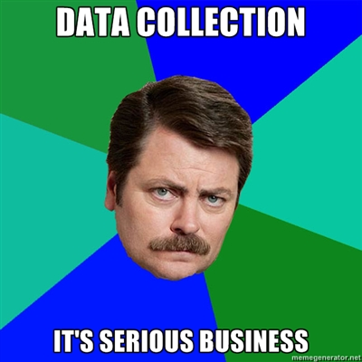
Data packaging:
A practical approach

Slide 3
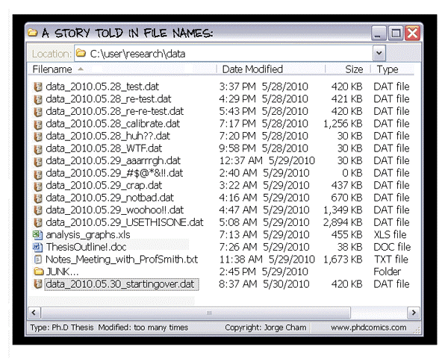

Slide 4


Slide 5
Responsible research conduct: data management/packaging
‘Inadequate record keeping or data management related to research projects’

Slide 6
Responsible research conduct: data management/packaging
‘Inadequate record keeping or data management related to research projects’
  27,5% (Martinson et al., 2005)
  48%! (Godecharle et al., 2017)

Slide 7
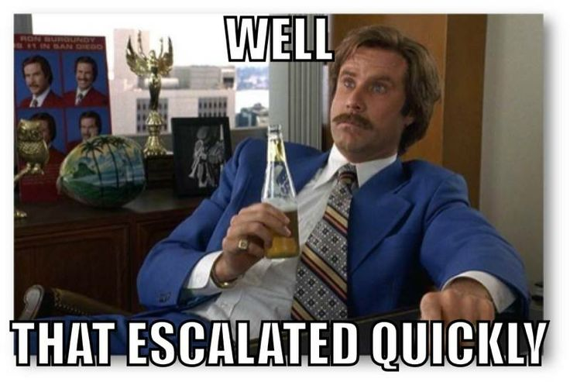
Responsible research conduct: data management/packaging
‘Inadequate record keeping or data management related to research projects’
  27,5% (Martinson et al., 2005)
  48%! (Godecharle et al., 2017)

Slide 8
Say that you wake up one morning with full amnesia related to your current project, but you are still a very capable scientist. Are you able to understand what you did the day before?

Slide 9
Data package: Metadata and materials
1. Metadata and data collection
  Author roles
  Who collected data/where/when/how
  ERB protocol number
2. Material
  All digital material that can be used to replicate project.
    Surveys/Stimuli/interview protocols/experiment leader protocol/computer scripts/etc. etc.

Slide 10
Data package: Raw data and analyses
3. Raw database
  Raw, time-marked datafile
  “Any information that could lead to the identification of participants (direct and indirect identifiers) must be removed from the data files.”
  In case you are not allowed to store these data in a repository: clearly explain and document the reasons for absence
4. Data processing and analyses
  Contain all information that allows others to replicate your study
    Coding schemes, syntaxes, computer scripts, statistical logbooks of raw data processing
    A sufficiently documented processed database
Notes:
--> The baseline should always be that data should be shared, except if for some good reason.

Slide 11
How does one achieve all these easily?
Notes:
--> The baseline should always be that data should be shared, except if for some good reason.

Slide 12
How does one achieve all these easily?
Transparency
&
Accountability
Notes:
--> The baseline should always be that data should be shared, except if for some good reason.

Slide 13
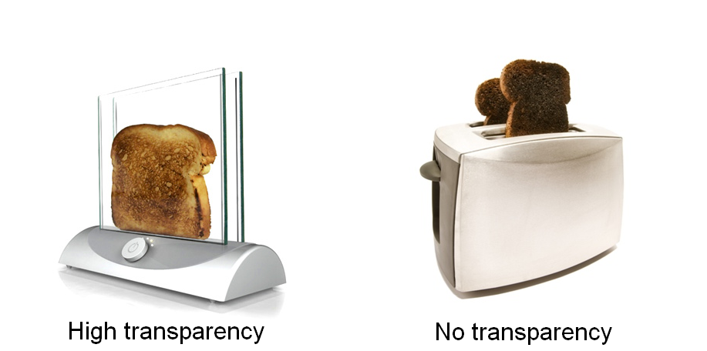
How does one achieve all these easily?
Transparency
&
Accountability
Notes:
--> The baseline should always be that data should be shared, except if for some good reason.

Slide 14
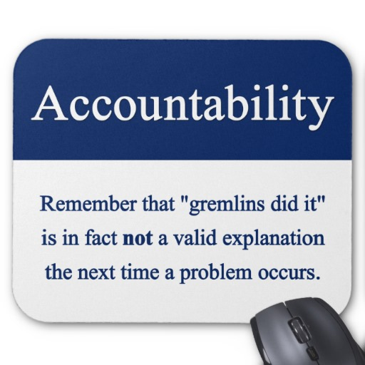
How does one achieve all these easily?
Transparency
&
Accountability
Notes:
--> The baseline should always be that data should be shared, except if for some good reason.

Slide 15
How does one achieve T&A?
Today, we’ll focus on two things:
Version control / log changes
Reproducibility
Notes:
--> The baseline should always be that data should be shared, except if for some good reason.

Slide 16
How does one achieve T&A?
Version control
=
Track changes for files
Notes:
--> The baseline should always be that data should be shared, except if for some good reason.

Slide 17

‘Normal’ version control
Adapted from Hartgerink (2016): http://bit.ly/chrisPM101

Slide 18
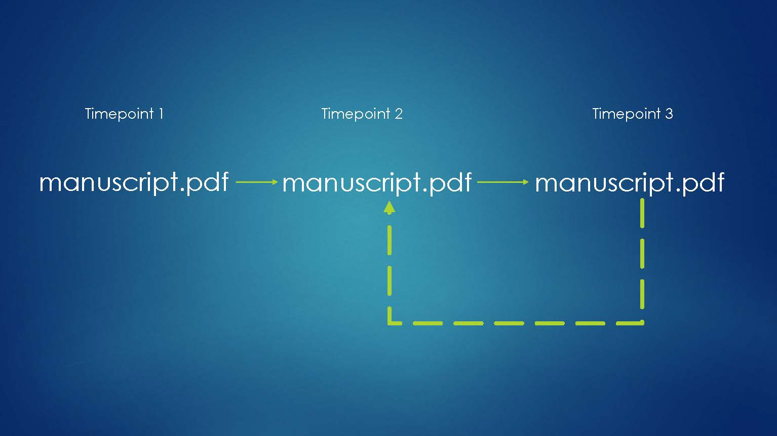
Actual version control
Adapted from Hartgerink (2016): http://bit.ly/chrisPM101

Slide 19
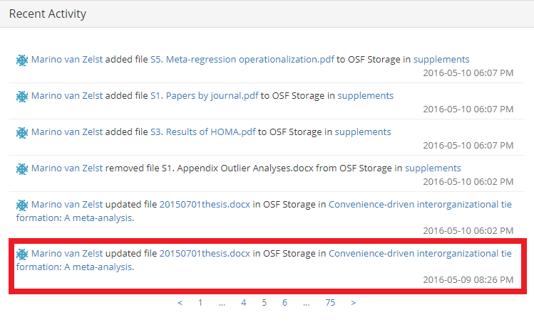

Slide 20
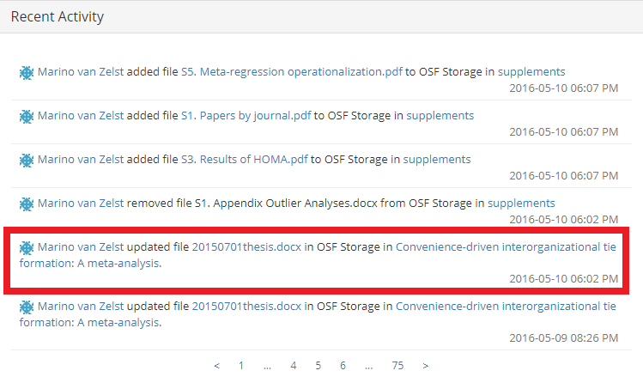

Slide 21
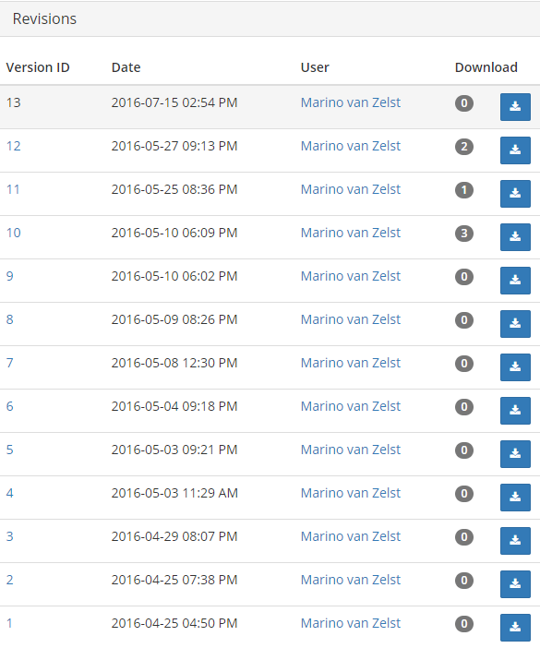

Slide 22
What if you don’t do version control (publicly)?

Slide 23
What if you don’t do version control (publicly)?

Slide 24
Adapted from Baum and Bromiley (2018)

Slide 25
How does one achieve transparency?
Open Science Framework
Online environment
Collaborative
Preregistration
Can make files public but not mandatory
Watch out: US servers (privacy!)
More advanced? Github/Bitbucket
Notes:
--> The baseline should always be that data should be shared, except if for some good reason.

Slide 26
How does one achieve transparency?
Ask ourselves continuously:
Can my future-self or anyone else reproduce this result within a reasonable amount of time?
Notes:
--> The baseline should always be that data should be shared, except if for some good reason.

Slide 27
Reproducibility
Data package requires you to:
Be able to reproduce all your results in reasonable amounts of time
Notes:
--> The baseline should always be that data should be shared, except if for some good reason.

Slide 28
Reproducibility
Data package requires you to:
Be able to reproduce all your results in reasonable amounts of time
Use syntax for everything!
Log WHY you use specific syntax
Notes:
--> The baseline should always be that data should be shared, except if for some good reason.

Slide 29
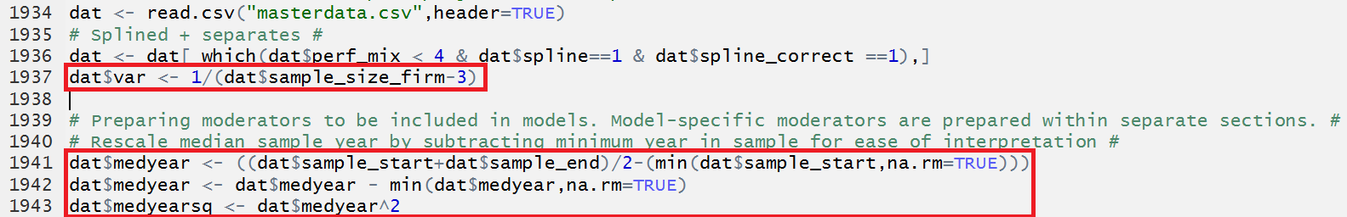
Reproducibility

Slide 30
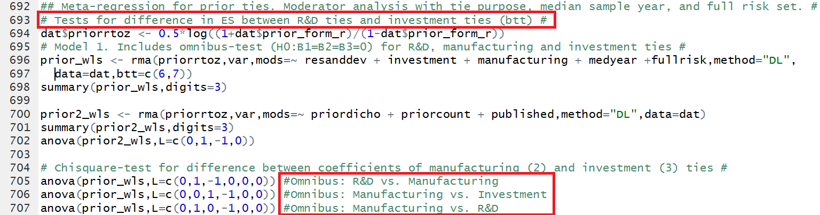

Slide 31
Reproducibility
The future: dynamic documenting
knitR, Rmarkdown
Code: Responses to historical performance feedback are heterogeneous, as the Q-statistic is `r round(all.hpfb_dv$QE,3)` (*p*-value = `r round(all.hpfb_dv$QEp,3)`)
Text: Responses to historical performance feedback are heterogeneous, as the Q-statistic is 392.468 (p-value = 0.003)

Slide 32
1) Will you be capable of reproducing your own results in half a year from now?

Slide 33
1) Will you be capable of reproducing your own results in half a year from now?
2) Will your co-authors be able to do this?

Slide 34
1) Will you be capable of reproducing your own results in half a year from now?
2) Will your co-authors be able to do this?
3) Will a colleague that is not a co-author be able to do this?

Slide 35
1) Will you be capable of reproducing your own results in half a year from now?
2) Will your co-authors be able to do this?
3) Will a colleague that is not a co-author be able to do this?
4) Will an independent researcher, who is in your area of expertise, be able to do this?

Slide 36
Assignment time
1) Will you be capable of reproducing your own results in half a year from now?
3) Will a colleague that is not a co-author be able to do this?
Assignment on OSF: https://osf.io/hz6an/

Slide 37
Data audit guidelines https://www.tilburguniversity.edu/research/social-and-behavioral-sciences/download-guideline-datapackage-tsb/
Find me if you want help with making your work (more) reproducible!
J.m.vanzelst@uvt.nl
@mzelst
S6.04

